Slide 1
18AIC302J Web programming for Artificial Intelligence UNIT-5 Topic : Create scrappers to extract contents from web documents

Slide 2
Unit 5: Topics
Introduction: Web Crawling Strategies
Creating Basic Scraper using scrapy
Extracting data from pages
Storing and process Documents and Requests
Techniques for extracting Data
Crawling Multiple Pages
Example Web Scrapper

Slide 3
Introduction: What is Web Crawling Strategies ?
Web crawling, also known as web scraping or spidering, is a fundamental concept in product analytics. It involves systematically and automatically browsing the internet to collect and organize information from web pages. This process is carried out by specialized computer programs called web crawlers or spiders.
Web crawling is the act of searching and indexing web pages to gather data for various purposes. Just like a spider traverses its web, web crawlers navigate through links on web pages to discover new content. They start with one or more initial URLs, retrieve the corresponding web pages, and then follow the hyperlinks within those pages to find additional URLs to crawl.
Web crawling is essential for various applications, such as search engine indexing, content aggregation, competitive intelligence, and market research. By systematically exploring the vast expanse of the internet, web crawlers can efficiently gather and index information from a multitude of sources.

Slide 4
How Web Crawling works?
Web crawlers automatically visit web pages and download their content. They follow the links present on these pages, allowing them to discover new URLs and continue the crawling process. The entire web is interconnected through these links, forming a vast network that web crawlers navigate to collect data.
During web crawling, the selected URLs are fetched, and the HTML or XML code of the web pages is extracted. This code is then parsed to identify the desired elements or data points, which are subsequently stored in structured formats, such as databases or spreadsheets. This collected data can be further processed and analyzed to gain insights and make informed product-oriented decisions.

Slide 5
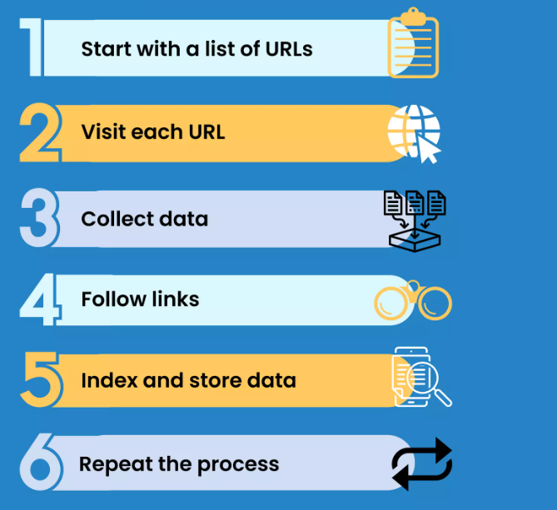
How Web Crawling works?

Slide 6
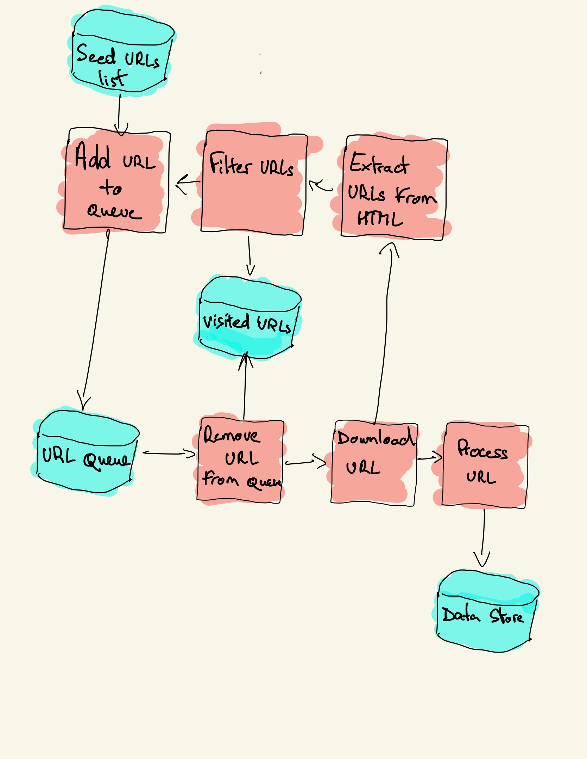
How Web Crawling works?
A web crawler starts with a list of URLs to visit, called the seed.
For each URL, the crawler finds links in the HTML, filters those links based on some criteria and adds the new links to a queue.
All the HTML or some specific information is extracted to be processed by a different pipeline.

Slide 7
Benefits of Web Crawling
Web crawling stands as a valuable tool for gathering and analyzing information at scale. It enables companies to gain a comprehensive understanding of their target audience, competitive landscape, and market trends.
By harnessing web crawling, businesses can extract and utilize valuable data to enhance their products, optimize pricing strategies, improve customer experiences, and stay ahead in the industry.

Slide 8
Applications of Web Crawling
Content Aggregation: Web crawling is employed to aggregate content from multiple sources and provide comprehensive information to users. News aggregators, price comparison websites, and product review platforms utilize web crawling to gather and present data from diverse websites.
Search Engine Indexing: Web crawling is the backbone of search engine indexing. Search engines like Google, Bing, and Yahoo use web crawlers to explore and index web pages, enabling users to find relevant information through search queries.
Competitive Intelligence: Web crawling helps organizations gather data on their competitors, enabling them to analyze their strategies, products, and market positioning. By monitoring competitor websites, pricing, and customer reviews, businesses can make informed decisions to stay ahead in the market.
Content Archiving: Web crawling contributes to content archiving efforts, preserving web pages for historical or reference purposes. Institutions, libraries, and researchers utilize web crawling to create archives of web-based content, ensuring valuable information is preserved over time.

Slide 9
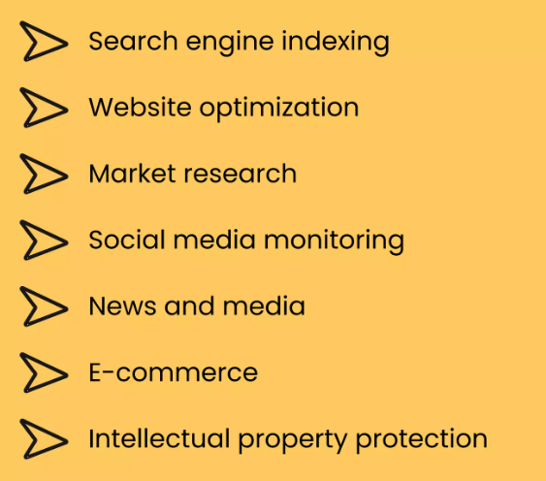
Applications of Web Crawling

Slide 10
Web Crawling Strategies
In practice, web crawlers only visit a subset of pages depending on the crawler budget, which can be a maximum number of pages per domain, depth or execution time.
Many websites provide a robots.txt file to indicate which paths of the website can be crawled, and which ones are off-limits. There's also sitemap.xml, which is a bit more explicit than robots.txt and specifically instructs bots which paths should be crawled and provide additional metadata for each URL.
Popular web crawler use cases include:
Search engines (e.g. Googlebot, Bingbot, Yandex Bot…) collect all the HTML for a significant part of the Web. This data is indexed to make it searchable.
SEO analytics tools on top of collecting the HTML also collect metadata like the response time, response status to detect broken pages and the links between different domains to collect backlinks.
Price monitoring tools crawl e-commerce websites to find product pages and extract metadata, notably the price. Product pages are then periodically revisited.
Common Crawl maintains an open repository of web crawl data. For example, the archive from May 2022 contains 3.45 billion web pages.

Slide 11
Web Crawling Strategies
Web crawling is a powerful technique to collect data from the web by finding all the URLs for one or multiple domains. Python has several popular web crawling libraries and frameworks.
There are three different strategies for building a web crawler in Python.
First, using only standard libraries, then third party libraries for making HTTP requests and parsing HTML, and, finally, a web crawling framework.

Slide 12
Building a simple web crawler in Python from scratch
To build a simple web crawler in Python we need at least one library to download the HTML from a URL and another one to extract links. Python provides the standard libraries urllib for performing HTTP requests and html.parser for parsing HTML. An example Python crawler built only with standard libraries can be found on Github.
There are also other popular libraries, such as Requests and Beautiful Soup, which may provide an improved developer experience when composing HTTP requests and handling HTML documents. If you wan to learn more, you can check this guide about the best Python HTTP client.
pip install requests bs4 ->You can install the two libraries locally
pip install requests beautifulsoup4

Slide 13
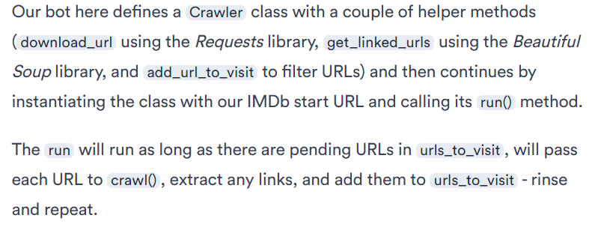
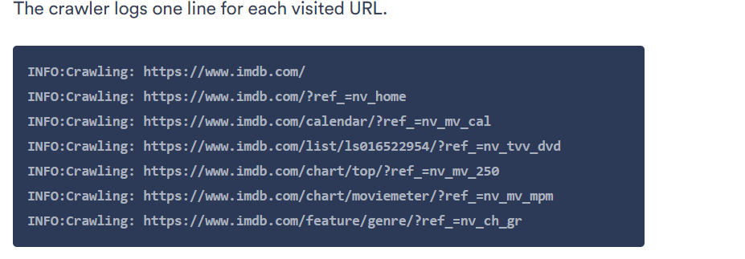
Building a simple web crawler in Python from scratch
First Technique: https://www.scrapingbee.com/blog/crawling-python/#web-crawling-with-scrapy
Output

Slide 14
Performance issue of First Technique
The code is very simple but there are many performance and usability issues to solve before successfully crawling a complete website.
The crawler is slow and supports no parallelism. As can be seen from the timestamps, it takes about one second to crawl each URL. Each time the crawler makes a request it waits for the response and doesn't do much else.
The download URL logic has no retry mechanism, the URL queue is not a real queue and not very efficient with a high number of URLs.
The link extraction logic doesn’t support standardizing URLs by removing URL query string parameters, doesn’t handle relative anchor/fragment URLs (i.e. href="#myanchor"), and doesn’t support filtering URLs by domain or filtering out requests to static files.
The crawler doesn’t identify itself and ignores the robots.txt file.

Slide 15
Second Technique:Web crawling with Scrapy
Scrapy is the most popular web scraping and crawling Python framework with close to 50k stars on Github. One of the advantages of Scrapy is that requests are scheduled and handled asynchronously. This means that Scrapy can send another request before the previous one has completed or do some other work in between. Scrapy can handle many concurrent requests but can also be configured to respect the websites with custom settings, as we’ll see later.
Scrapy has a multi-component architecture. Normally, you will implement at least two different classes: Spider and Pipeline. Web scraping can be thought of as an ETL where you extract data from the web and load it to your own storage. Spiders extract the data and pipelines load it into the storage. Transformation can happen both in spiders and pipelines, but I recommend that you set a custom Scrapy pipeline to transform each item independently of each other. This way, failing to process an item has no effect on other items.

Slide 16
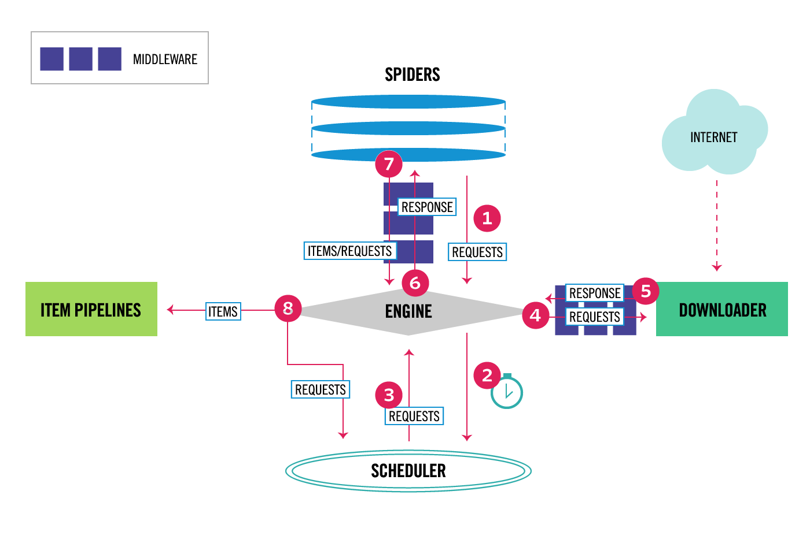
Second Technique:Web crawling with Scrapy
On top of all that, you can add spider and downloader middlewares in between components as it can be seen in the diagram below. Below shows Scrapy Architecture Overview.

Slide 17
Second Technique:Web crawling with Scrapy
A web scraper is defined as a class that inherits from the base Spider class and implements a parse method to handle each response.
Check code: https://www.scrapingbee.com/blog/crawling-python/#web-crawling-with-scrapy

Slide 18
Extracting data from pages
Manual copy and paste: A simple method for small amounts of data that's easily accessible. Copy and paste the data into a spreadsheet or other document.
Web browser extensions: Install extensions that let you select and extract specific data points from a website.
Web scraping: An automated method that uses software called web scrapers to extract data from web pages. Web scraping can be done using Python libraries like BeautifulSoup, Selenium, and Scrapy. You can also use tools like Apify or DataSnipper to scrape data from specific sites.
Scraping is a two step process:
Systematically finding and downloading web pages.
Extract information from the downloaded pages.

Slide 19
Web Scraping vs Web Crawling
Web Scraping is a technique used to extract a large amount of data from websites and then saving it to the local machine in the form of XML, excel or SQL.
The tools used for web scraping are known as web scrapers.
On the basis of the requirements given, they can extract the data from any website in a fraction of time. This automation of tasks is very helpful for developing data for machine learning and other purpose.
They work in four steps:
Sending the request to the target page.
Getting response from the target page.
Parsing and extracting the response.
Download the data.
Some of the popular web scraping tools are ProWebScraper, Webscraper.io, etc.

Slide 20
Web Scraping vs Web Crawling
Purpose: of Web Scraping: To collect specific pieces of data from one or more web pages.
Use Cases:
Collecting product prices from e-commerce websites.
Extracting contact information from directories.
Gathering data for market research or academic purposes.

Slide 21
Web Scraping vs Web Crawling
Ex of Web Scraping
import requests
from bs4 import BeautifulSoup
url = 'https://www.bbc.com/weather/2643743'
response = requests.get(url)
soup = BeautifulSoup(response.content, 'html.parser')
temperature_element = soup.find('span', {'class': 'wr-value--temperature--c'})
if temperature_element is not None:
print(temperature_element.text)
else:
print('Temperature element not found')

Slide 22
Web Scraping vs Web Crawling
Web Crawling is analogous to a spider crawling but the place of crawling here is the web!. It basically visits a website and read web pages for the purpose of building entries for search engine index.
The tools that are used for web crawling are known as web crawlers or spiders.
A series of web pages are analyzed and links to the pages on them are then followed for even more links thus it does a deep search for extracting of information.
Famous search engines such as Google, Yahoo and Bing do web crawling and use this information for indexing web pages. Examples are Scrapy and Apache nut.
Purpose: To traverse and index the content of many web pages automatically.

Slide 23
Web Scraping vs Web Crawling
Process of Web Crawler:
Seed URLs: Start with a list of initial URLs to visit.
Fetch: Retrieve the content of the webpage.
Extract Links: Identify and extract links to other pages from the current page.
Repeat: Follow these links and repeat the process, thus creating a network of crawled pages.
Use cases of Web Crawling:
Search engines (e.g., Google) use web crawlers to index the web.
Gathering comprehensive data for data analysis and big data applications.
Monitoring changes on websites for updates or new content.

Slide 24
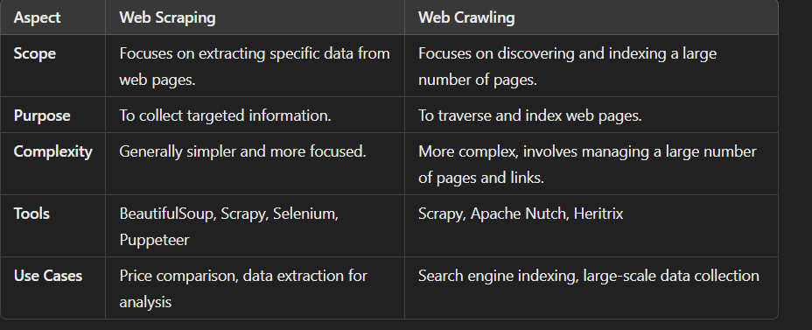
Web Scraping vs Web Crawling

Slide 25
Step 1: Creating a Basic Scraper
Scrapy is one of the most popular and powerful Python scraping libraries; it takes a “batteries included” approach to scraping, meaning that it handles a lot of the common functionality that all scrapers need so developers don’t have to reinvent the wheel each time.
Scrapy, like most Python packages, is on PyPI (also known as pip). PyPI, the Python Package Index, is a community-owned repository of all published Python software.
pip install scrapy
With Scrapy installed, create a new folder for our project. You can do this in the terminal by running:
mkdir quote-scraper
Now, navigate into the new directory you just created:
cd quote-scraper

Slide 26
Step 1: Creating a Basic Scraper
Then create a new Python file for our scraper called scraper.py. We’ll place all of our code in this file for this tutorial. You can create this file using the editing software of your choice.
Start out the project by making a very basic scraper that uses Scrapy as its foundation. To do that, you’ll need to create a Python class that subclasses scrapy.Spider, a basic spider class provided by Scrapy. This class will have two required attributes:
name — just a name for the spider.
start_urls — a list of URLs that you start to crawl from. We’ll start with one URL.
Open the scrapy.py file in your text editor and add this code to create the basic spider:

Slide 27
Step 1: Creating a Basic Scraper
import scrapy
class QuoteSpider(scrapy.Spider):
name = 'quote-spdier'
start_urls = ['https://quotes.toscrape.com’]
First, we import scrapy so that we can use the classes that the package provides.
Next, take the Spider class provided by Scrapy and make a subclass out of it called BrickSetSpider. Think of a subclass as a more specialized form of its parent class. The Spider class has methods and behaviors that define how to follow URLs and extract data from the pages it finds, but it doesn’t know where to look or what data to look for. By subclassing it, we can give it that information.
Finally, name the class quote-spider and give our scraper a single URL to start from: https://quotes.toscrape.com. If you open that URL in your browser, it will take you to a search results page, showing the first of many pages of famous quotations.
Now, test the scraper. Typically, Python files are run with a command like python path/to/file.py. However, Scrapy comes with its own command line interface to streamline the process of starting a scraper. Start your scraper with the following command:

Slide 28
Step 2 and 3: Extracting Data from a Page
Step 2: Extracting Data from a Page
Step 3 — Crawling Multiple Pages
https://www.digitalocean.com/community/tutorials/how-to-crawl-a-web-page-with-scrapy-and-python-3

Slide 29
Storing and process Documents and Requests
To store and process documents and requests, you can extend the web crawler to save the downloaded HTML content of each page to files and maintain a log of requests and responses. This way, you can keep a record of each document fetched and revisit them later for processing.
Storing HTML Documents
You can save the HTML content of each crawled page to a file, using a naming convention that helps identify each document. This can be done by creating a directory to store the files and naming each file based on the URL or a unique identifier.
Logging Requests and Responses
You can also maintain a log of all requests and responses, including timestamps, URLs, and any relevant status information. This will help you track the crawling process and diagnose any issues that arise.
Here's an updated version of the crawler that stores HTML documents and logs requests and responses:

Slide 30
Steps: Storing and process Documents and Requests
Document Storage:
Directory Creation: A directory named documents is created to store the HTML files.
Filename Generation: Filenames are generated based on the URL, replacing slashes with underscores to avoid issues with file paths.
Saving HTML: The save_html_document method saves the HTML content to a file in the documents directory.
Request Logging: The logging configuration records all actions, including adding URLs, crawling URLs, and saving documents.
Data Extraction: The extract_data method is used to extract specific data (titles) from the HTML content.
Crawl and Run Methods: The crawl method is responsible for downloading, saving, and processing each page, while the run method manages the overall crawling process.

Slide 31
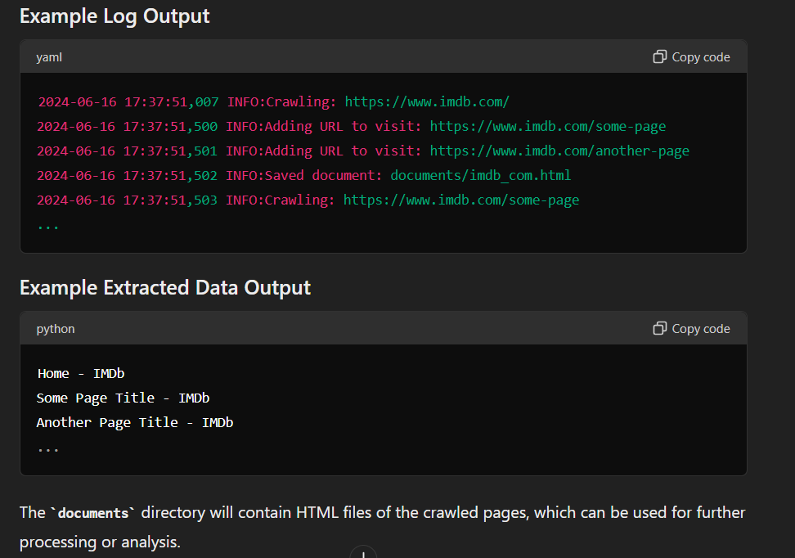
Steps: Storing and process Documents and Requests
Running the Code:Install Required Libraries:!pip install requests beautifulsoup4
Copy and Paste the Updated Code: Copy the updated code into a Jupyter Notebook cell and execute it.
Output: The crawler will log its activities and save HTML documents in the documents directory. Extracted data (page titles) will be printed at the end. The logs will help you trace the process and debug any issues.

Slide 32
Techniques for extracting Data: Regular Expressions
Extracting data from web pages, known as web scraping, can be accomplished using various techniques. These techniques range from simple methods like regular expressions to more complex approaches involving libraries and frameworks. Here are some common techniques for extracting data from web pages:
1. Regular Expressions: Regular expressions (regex) can be used to match patterns in the HTML content. This method is simple but can be brittle if the structure of the web page changes.
import re
import requests
url = 'https://example.com'
response = requests.get(url)
html = response.text
# Extract titles using regex
titles = re.findall('<title>(.*?)</title>', html)
print(titles)

Slide 33
Techniques for extracting Data: Beautiful soup
2. BeautifulSoup is a popular Python library for parsing HTML and XML documents. It creates a parse tree from the page source code and provides methods for navigating and searching the tree.
import requests from bs4
import BeautifulSoup
url = 'https://example.com’
response = requests.get(url)
soup = BeautifulSoup(response.text, 'html.parser’)
# Extract titles
titles = soup.find_all('title’)
for title in titles:
print(title.text)

Slide 34
Techniques for extracting Data: Scrapy
3. Scrapy is a powerful and flexible web crawling and web scraping framework for Python. It provides tools for extracting data from websites and handling many complex crawling scenarios.
# First, install Scrapy with: pip install scrapy
# Create a new Scrapy project:
# scrapy startproject myproject
# Then, create a spider in the project:
import scrapy
class ExampleSpider(scrapy.Spider):
name = 'example'
start_urls = ['https://example.com']
def parse(self, response):
for title in response.css('title::text'):
yield {'title': title.get()}
# Run the spider with: scrapy crawl example

Slide 35
Example Web Scraper
Here's a complete example of a simple web scraper using Python and the BeautifulSoup library. This scraper will extract article titles from the homepage of a news website, such as BBC News.
Step 1: Install Required Libraries: pip install requests beautifulsoup4
Step 2: Create the Web Scraper: Here's the complete code for a simple web scraper that fetches article titles from BBC News.
Step 3: Run the Scraper: scrape_bbc_news()
https://www.digitalocean.com/community/tutorials/how-to-crawl-a-web-page-with-scrapy-and-python-3

Slide 36
Example Web Scraper
import requests
from bs4 import BeautifulSoup
# Function to scrape article titles from BBC News
def scrape_bbc_news():
url = 'https://www.bbc.com/news'
response = requests.get(url)
# Check if the request was successful
if response.status_code != 200:
print(f'Failed to retrieve the web page. Status code: {response.status_code}')
return
# Parse the HTML content
soup = BeautifulSoup(response.content, 'html.parser')
# Find all article titles
titles = soup.find_all('h3', class_='gs-c-promo-heading__title')
# Print the titles
for i, title in enumerate(titles, 1):
print(f'{i}. {title.text}')
# Run the scraper
scrape_bbc_news()

